Slide 1

Project Evaluation Presentation
Integrella IT PVT LTD

Slide 2

Introduction Never ask “what time works for you?” again.
-APPOINTMENT SCHEDULER

Slide 3
The project is an appointment booking system that provides users an easy way of booking an appointment online. This is a web-based application that overcomes the issue of managing and booking appointments according to user's choice or demands
-APPOINTMENT SCHEDULER

Slide 4
Purpose: Easy to use Booking system with available time slots. Compatible with UPI Payment system.
-appointment scheduler

Slide 5

Features: 1 Ability to easily view the available slots. 2 Ability to accept online payments. 3 Easily process your payments online in secure manner. 4 Meet people anywhere through video conferencing integrations.
- APPOINTMENT scheduler

Slide 6

Tools, Technologies, API’s and Libraries React JS Node JS Zoom Api Razor Pay Api PostgreSql
- APPOINTMENT SCHEDULER

Slide 7
My Contribution in the project.
Used Dev-extreme library, for making frontend UI of the Scheduler App.
Made Backend for saving/retrieving appointments.
Integrated other functionalities in the app with other team members.

Slide 8
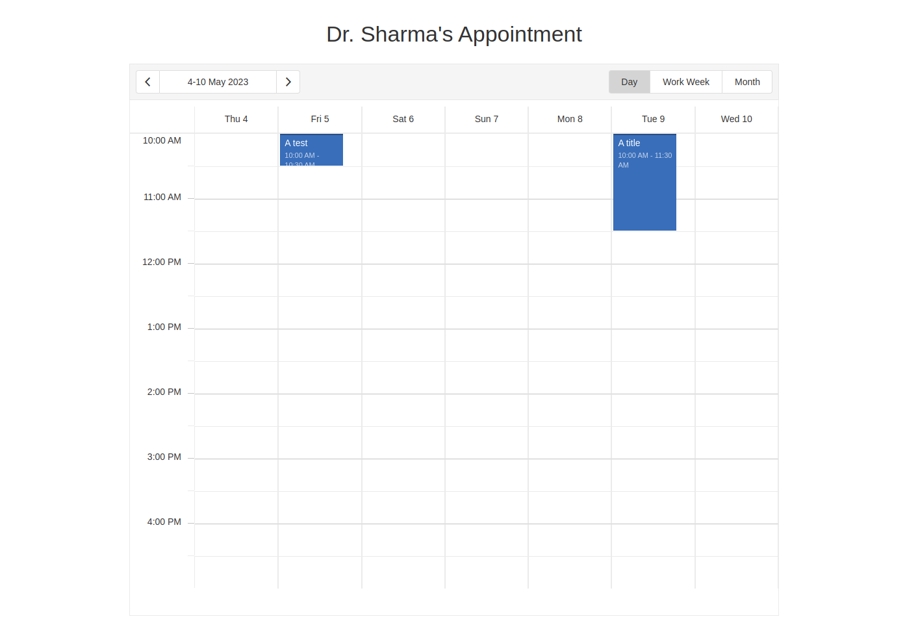
Dashboard

Slide 9
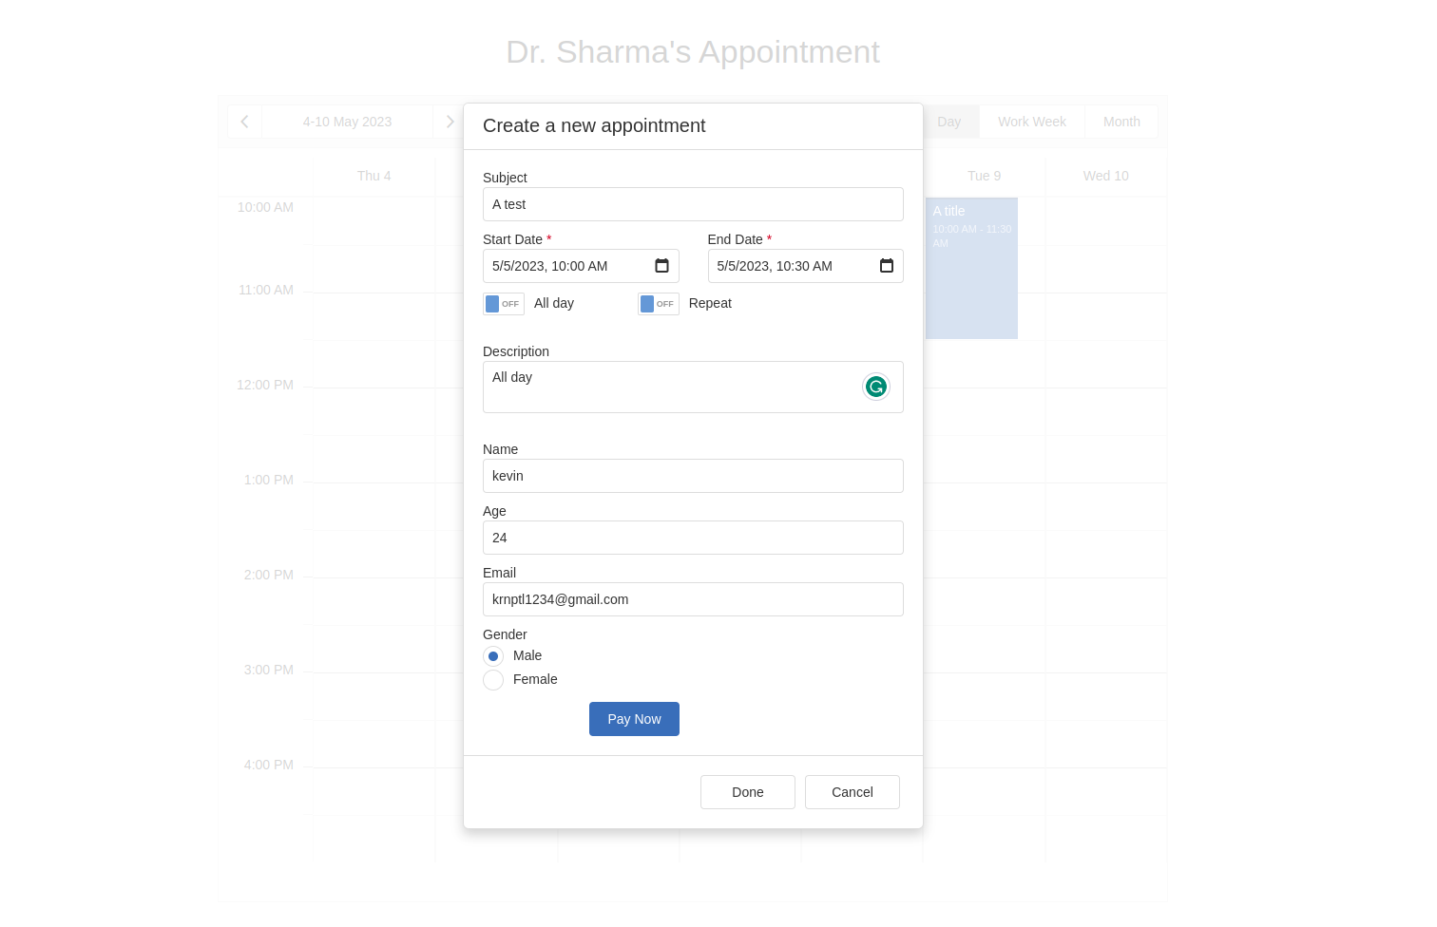
New Appointment

Slide 10
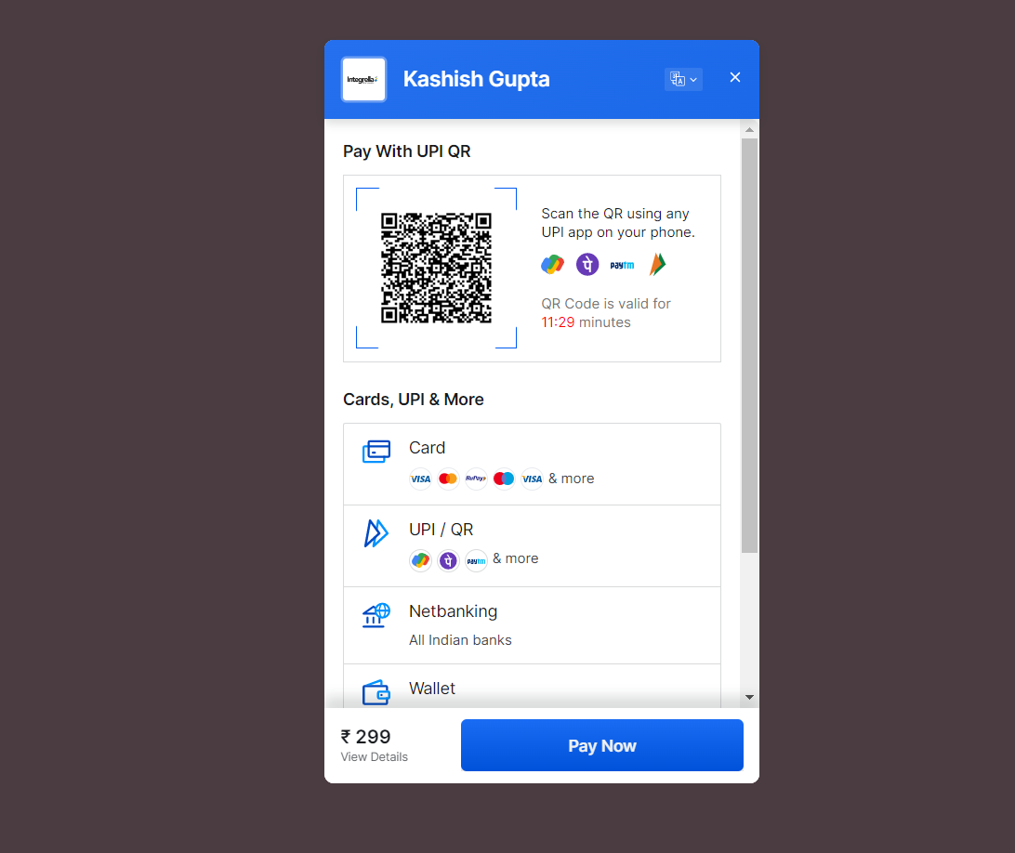
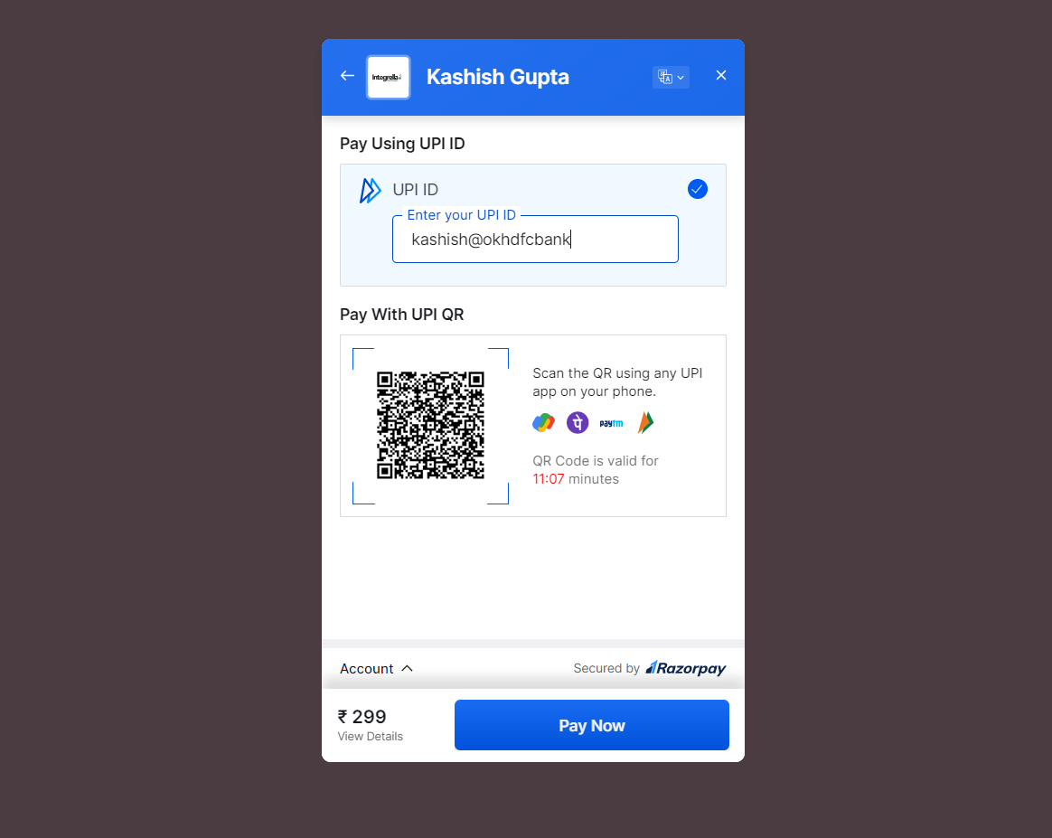
Payment Gateway

Slide 11
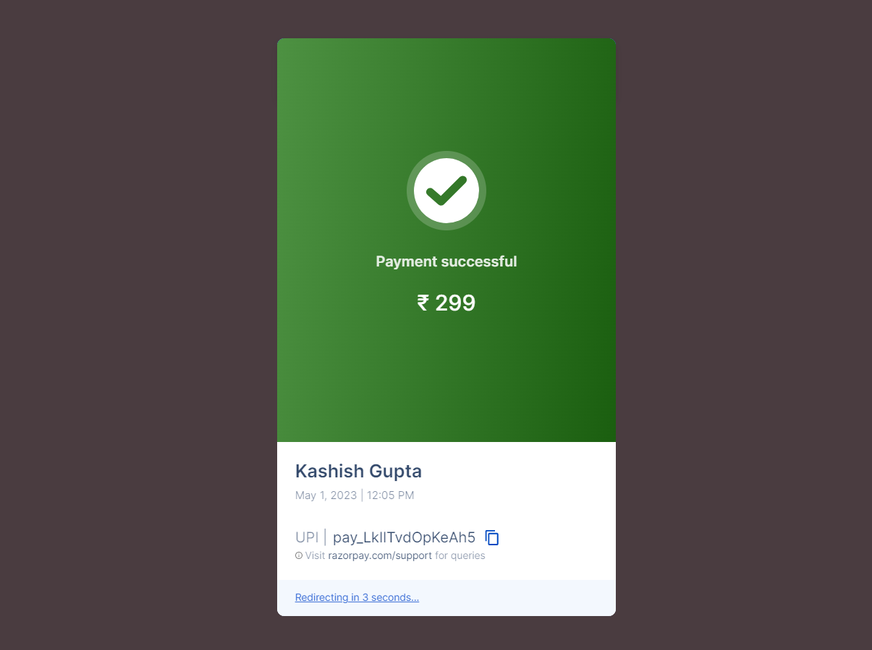
Payment Gateway

Slide 12
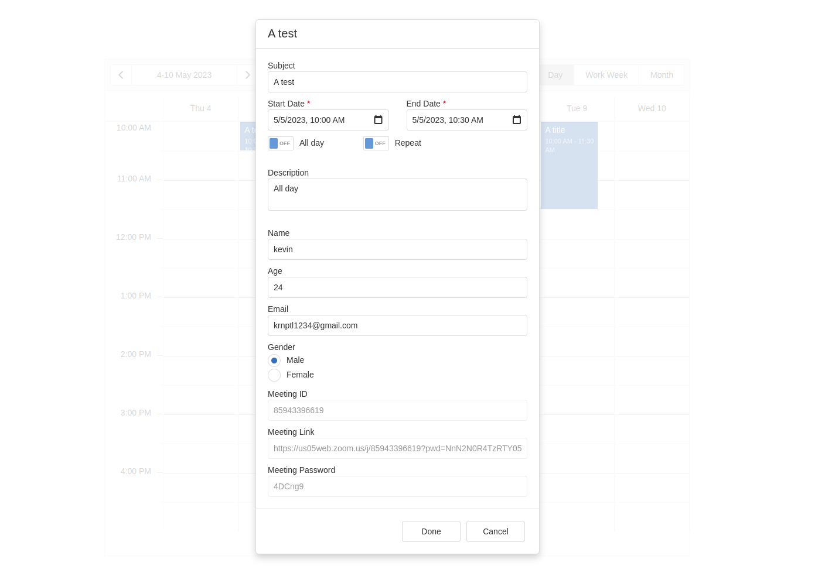
Meeting Link Details

Slide 13
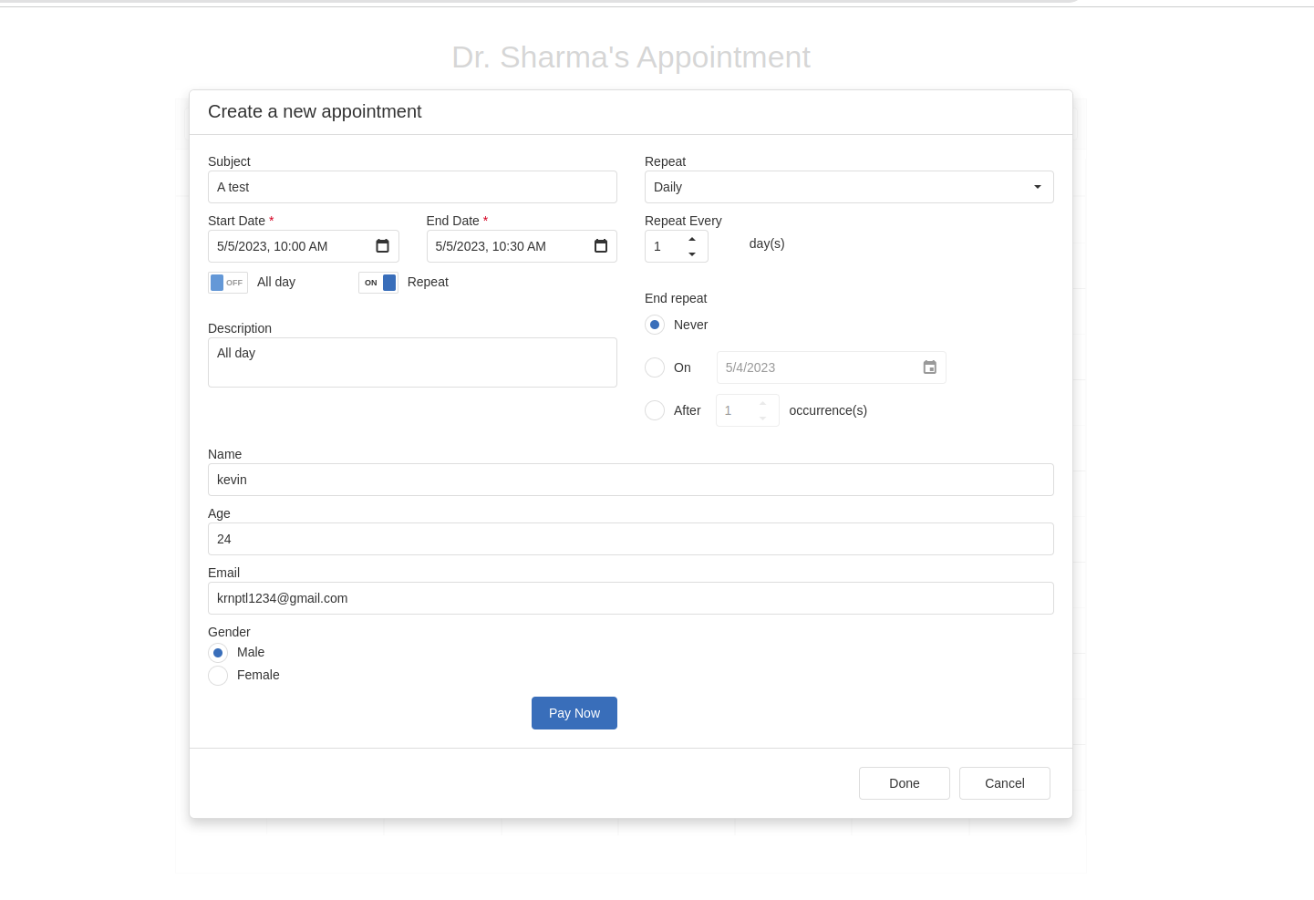
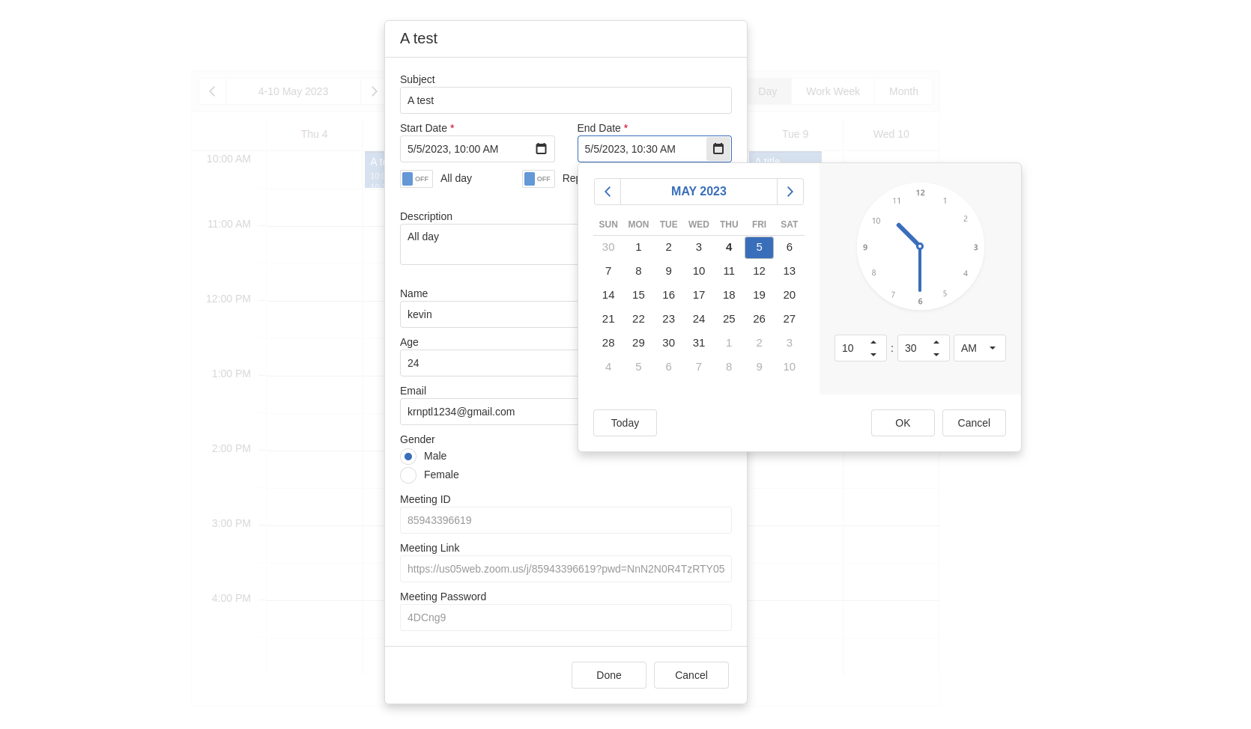

Slide 14


Thank you

